Slide 1

ASSIGNMENT Name: Prakhar
Problem Statement The sales pipeline conversion percentage at TechnoServe (a tech SaaS startup) has dropped from 35% at the end of last fiscal (FY 2017-18) to 25% at present.
Assignment Objective
Understand the problem, come up with a hypothesis for low conversions faced by TechnoServe, and analyse the dataset provided to arrive at possible solutions to increase it.
Notes:
Problem Statement

Slide 2
PART I : 1. Understanding the Problem Sales Pipeline Conversion at a SaaS Startup
Who?
TechnoServe, the tech SaaS startup.
What?
Decline in sales pipeline conversion rate, in comparison to market standards.
When?
Occurring since the end
of the year 2018-19.
Where?
Among the sales, tele-sales and marketing team.
How?
Inability to meet financial targets.
Inability to generate enough money for future pipeline conversions.

Slide 3
PART I : 2. Understanding the Problem Sales Pipeline Conversion at a SaaS Startup
Situation
What type of platform is being used to develop the software product?
What is the status of the reports that the company has?
What is the current situation of the marketing team and its conversion rate?
Problem
What is the main problem leading to such low conversion rates?
Are the customers not fully satisfied with the prototype?
Is the right segment of customers being targeted for the sale of the product?
Implication
What impact do these low conversions have on the company?
How did cost cutting in various channels affect the company?
Do the customers
Need-Payoff
Would it help if we try to improve the quality of the final product?
Would it help if we try to analyze the type of potential clients being approached for the product?
How will
Notes:
Provide at least three questions under each branch.

Slide 4
PART II : Formulating Hypotheses Sales Pipeline Conversion at a SaaS Startup
Framework Used
4 P’s framework.
Reason for using the selected framework
The 4 P’s framework is used here because it effectively tells us whether the product designed by the company serves its purpose to the customer or not. Furthermore, it tells us about the effectiveness of the communication between the company and the client. Therefore, this framework will definitely help us to understand the problem clearly and develop an effective solution to it.
How you have used the framework here
The leading cause of low conversion rate is divided into 4 major branches (4 P’s), i.e. Product, Price, Promotion and Place. Further, they are branched into subsequent branches until a hypotheses can be formulated for it. These hypotheses are assigned weightage according to the priorities assigned to them. Therefore, we generate a set of hypotheses to solve the problem.
Notes:
All the frameworks that are used should be mentioned.
A suitable reason is a must to provide here

Slide 5
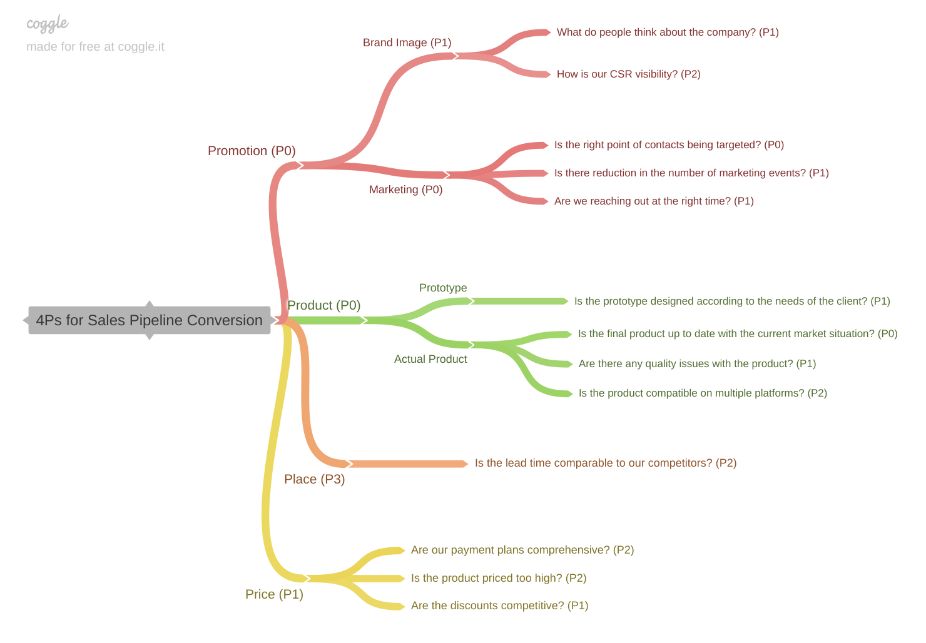
PART II : Formulating Hypotheses Sales Pipeline Conversion at a SaaS Startup
Notes:
Use the “download as” feature of Coggle if you are using the tool.
Provide one image with complete tree along with separate elements where the text is readable.
Copy the slide if you require more space

Slide 6
PART II : Formulating Hypotheses Sales Pipeline Conversion at a SaaS Startup
Branch 1
4Ps for Sales Pipeline Conversion – Promotion (P0) – Brand Image (P1) – What do people think about the company? (P1)
Branch 2
4Ps for Sales Pipeline Conversion – Promotion (P0) – Brand Image (P1) – How is our CSR visibility? (P2)
Notes:
Each branch must follow this naming pattern: Problem – Branch 1 – Sub-branch 1 – Sub-branch 2 – …… – Hypotheses
There must be minimum 10 hypotheses in total and at least 1 in each branch.

Slide 7
PART II : Formulating Hypotheses Sales Pipeline Conversion at a SaaS Startup
Branch 3
4Ps for Sales Pipeline Conversion – Promotion (P0) – Marketing (P0) – Is the right point of contacts being targeted? (P0)
Branch 4
4Ps for Sales Pipeline Conversion – Promotion (P0) – Marketing (P0) – Is there reduction in the number of marketing events? (P1)
Notes:
Each branch must follow this naming pattern: Problem – Branch 1 – Sub-branch 1 – Sub-branch 2 – …… – Hypotheses
There must be minimum 10 hypotheses in total and at least 1 in each branch.

Slide 8
PART II : Formulating Hypotheses Sales Pipeline Conversion at a SaaS Startup
Branch 5
4Ps for Sales Pipeline Conversion – Promotion (P0) – Marketing (P0) – Are we reaching out at the right time? (P1)
Branch 6
4Ps for Sales Pipeline Conversion – Product (P0) – Prototype – Is the prototype designed according to the needs of the customer? (P1)
Notes:
Each branch must follow this naming pattern: Problem – Branch 1 – Sub-branch 1 – Sub-branch 2 – …… – Hypotheses
There must be minimum 10 hypotheses in total and at least 1 in each branch.

Slide 9
PART II : Formulating Hypotheses Sales Pipeline Conversion at a SaaS Startup
Branch 7
4Ps for Sales Pipeline Conversion - Product (P0) – Actual Product – Is the final product up to date with the current market situation? (P0)
Branch 8
4Ps for Sales Pipeline Conversion - Product (P0) – Actual Product – Are there any quality issues with the product? (P1)
Notes:
Each branch must follow this naming pattern: Problem – Branch 1 – Sub-branch 1 – Sub-branch 2 – …… – Hypotheses
There must be minimum 10 hypotheses in total and at least 1 in each branch.

Slide 10
PART II : Formulating Hypotheses Sales Pipeline Conversion at a SaaS Startup
Branch 9
4Ps for Sales Pipeline Conversion - Product (P0) – Actual Product – Is the product compatible on multiple platforms? (P2)
Branch 10
4Ps for Sales Pipeline Conversion – Place (P3) – Is the lead time comparable to our competitors? (P2)
Notes:
Each branch must follow this naming pattern: Problem – Branch 1 – Sub-branch 1 – Sub-branch 2 – …… – Hypotheses
There must be minimum 10 hypotheses in total and at least 1 in each branch.

Slide 11
PART II : Formulating Hypotheses Sales Pipeline Conversion at a SaaS Startup
Branch 11
4Ps for Sales Pipeline Conversion – Price (P1) – Are our payment plans comprehensive? (P2)
Branch 12
4Ps for Sales Pipeline Conversion – Price (P1) – Is the product priced too high? (P2)
Notes:
Each branch must follow this naming pattern: Problem – Branch 1 – Sub-branch 1 – Sub-branch 2 – …… – Hypotheses
There must be minimum 10 hypotheses in total and at least 1 in each branch.

Slide 12
PART II : Formulating Hypotheses Sales Pipeline Conversion at a SaaS Startup
Branch 13
4Ps for Sales Pipeline Conversion – Price (P1) – Are the discounts competitive? (P1)
Notes:
Each branch must follow this naming pattern: Problem – Branch 1 – Sub-branch 1 – Sub-branch 2 – …… – Hypotheses
There must be minimum 10 hypotheses in total and at least 1 in each branch.

Slide 13
PART III A : Generating Insights Sales Pipeline Conversion at a SaaS Startup
Variable
Technology Primary
B2B Sales Medium
Revenue Sizing
Opportunity Sizing
Insights if any
The conversion rate of the “legacy modernization” solution offered to the clients is nearly half the average conversion rate.
The “Online Leads” medium has a drastically low conversion rate of about 6.5% only.
The number of clients having their average quarterly income “less than $100K” is unusually high, about 59,500.
Clients with the potential revenue “between $40K to $50K” have a low conversion rate of about one-fourth compared to those having the potential revenue “less than $10K.”
Pattern of Insight
Surprising Comparison
Significant Outliers
Significant Outlier
Surprising Extremes
Notes:
Analyse the variables in the dataset, find the insights and mention the pattern of insights in the data. Make more copies of this slide if needed.

Slide 14
PART III A : Generating Insights Sales Pipeline Conversion at a SaaS Startup
Variable
Business from Client Last Year
City
Sales Velocity
Insights if any
Despite being the most targeted segment, the conversion rates for clients having “no history of business” in the previous year is extremely low.
The conversion rate for the city “Pune” is slightly lower than the average conversion rate, and it is about 19%.
The conversion rate for clients who have spent “more than 94 days” in the sales stage is 100%.
Pattern of Insight
Surprising Extremes
Unknown Result
Significant Outliers
Notes:
Analyse the variables in the dataset, find the insights and mention the pattern of insights in the data. Make more copies of this slide if needed.

Slide 15
PART III A : Generating Insights Sales Pipeline Conversion at a SaaS Startup
Variable under consideration: Technology Primary
It can be clearly seen from the pivot table created here that the “Legacy Modernization” solutions offered to the clients have drastically lower conversion rates in comparison to the average conversion rate. Also, the “Analytics” solutions tend to have a slightly higher average conversion rate percentage.
Notes:
For each variable that produced an interesting insight, explain you analysis bit here – the results you got from excel and the necessary visualisations. Note: it is compulsory for you to mention the results of the analysis on these variables - 'Technology Primary', 'B2B Sales Medium', 'Client Revenue Sizing', 'Opportunity Sizing' and 'Business from Client last year’.

Slide 16
PART III A : Generating Insights Sales Pipeline Conversion at a SaaS Startup
Variable under consideration: B2B Sales Medium
As it can be seen from the conditionally formatted pivot table, the “Online Leads” segment of the B2B Sales Medium has the conversion rate nearly one-fourth of the average conversion rate. Furthermore, it is the least used medium to sell the product. Also, it can be seen that the “Tele Sales” segment of the sales medium “completely fails” to convert any potential client into a final customer. Also, the “Enterprise Sellers” sale medium has a high conversion rate while selling “Analytical technology products”.
Notes:
For each variable that produced an interesting insight, explain you analysis bit here – the results you got from excel and the necessary visualisations. Note: it is compulsory for you to mention the results of the analysis on these variables - 'Technology Primary', 'B2B Sales Medium', 'Client Revenue Sizing', 'Opportunity Sizing' and 'Business from Client last year’.

Slide 17
PART III A : Generating Insights Sales Pipeline Conversion at a SaaS Startup
Variable under consideration: Client Revenue Sizing
From the pivot table created, it can be clearly seen that the a very large number of clients with “average quarterly revenue less than $100K”
have been targeted by the sales team. Also, while comparing the “average quarterly revenue” of the clients with market competitors, it can be seen that the company has a slightly greater conversion rate for which there was “no competition” in the market.
Notes:
For each variable that produced an interesting insight, explain you analysis bit here – the results you got from excel and the necessary visualisations. Note: it is compulsory for you to mention the results of the analysis on these variables - 'Technology Primary', 'B2B Sales Medium', 'Client Revenue Sizing', 'Opportunity Sizing' and 'Business from Client last year’.

Slide 18
PART III A : Generating Insights Sales Pipeline Conversion at a SaaS Startup
Variable under consideration: Opportunity Sizing
It can be evidently seen from the conditionally formatted pivot table that clients with “potential revenue more than $50K” were less targeted. Another interesting point to note down is the fact that the conversion rate for clients having “potential revenue in between $40K to $50K” have a very “low conversion rate of about 11.7%”. On the contrary, those with “potential revenue less than $10K” have a high conversion rate, nearly “double the average conversion rate”.
Notes:
For each variable that produced an interesting insight, explain you analysis bit here – the results you got from excel and the necessary visualisations. Note: it is compulsory for you to mention the results of the analysis on these variables - 'Technology Primary', 'B2B Sales Medium', 'Client Revenue Sizing', 'Opportunity Sizing' and 'Business from Client last year’.

Slide 19
PART III A : Generating Insights Sales Pipeline Conversion at a SaaS Startup
Variable under consideration: Business from client last year
It can be inferred from the given analysis that “the number of clients who did not generate any revenue in the past year” was the “most targeted” segment. However, despite being the most targeted segment, its conversion rate was “extremely low(nearly one-fifth of the highest conversion rate segment) in comparison to other segments which in turn greatly affected the overall conversion rate.
Notes:
For each variable that produced an interesting insight, explain you analysis bit here – the results you got from excel and the necessary visualisations. Note: it is compulsory for you to mention the results of the analysis on these variables - 'Technology Primary', 'B2B Sales Medium', 'Client Revenue Sizing', 'Opportunity Sizing' and 'Business from Client last year’. Make more copies of this slide if needed.

Slide 20
PART III A : Generating Insights Sales Pipeline Conversion at a SaaS Startup
Variable under consideration: City
From the given clustered column chart it can be seen that surprisingly, “Chennai” had a sharply higher conversion rate for the “Online Leads” sales medium when compared to other cities. Also, for the “Tele Sales” segment of sales medium, “Bengaluru” and “Chennai” had slightly “lower conversion rates”.
Notes:
For each variable that produced an interesting insight, explain you analysis bit here – the results you got from excel and the necessary visualisations. Note: it is compulsory for you to mention the results of the analysis on these variables - 'Technology Primary', 'B2B Sales Medium', 'Client Revenue Sizing', 'Opportunity Sizing' and 'Business from Client last year’. Make more copies of this slide if needed.

Slide 21
PART III A : Generating Insights Sales Pipeline Conversion at a SaaS Startup
Variable under consideration: Sales Velocity
It is clear from the line chart that the clients who spend “more than 93 days in the sales stage” have a “100% conversion rate”, irrespective of any other factors. This is a major insight and it can be used effectively to boost the conversion rate in the future.
Notes:
For each variable that produced an interesting insight, explain you analysis bit here – the results you got from excel and the necessary visualisations. Note: it is compulsory for you to mention the results of the analysis on these variables - 'Technology Primary', 'B2B Sales Medium', 'Client Revenue Sizing', 'Opportunity Sizing' and 'Business from Client last year’. Make more copies of this slide if needed.

Slide 22
PART III A : Generating Insights Sales Pipeline Conversion at a SaaS Startup
Recommendations
Targeting customers who generated a revenue less than $25K in the past year.
Engaging the clients for at least 90 days in the sales stage from now on.
Ignoring Online Leads as a medium to sell the products to the clients.
Ignoring customers who did not generate any revenue in the past year.
Corresponding Insights
This is because clients who generated a revenue in between $0 to $25K in the past year showed a whopping conversion rate of about 83%.
The clients who spend “more than 93 days in the sales stage” have a “100% conversion rate”, irrespective of any other factors.
The “Online Leads” segment of the B2B Sales Medium has the conversion rate nearly one-fourth of the average conversion rate. Also, it is the least used medium to sell the product.
Despite being the most targeted segment, the conversion rates for clients having “no history of business” in the previous year is extremely low.
Notes:
For each recommendation explain the insights that form the reasoning for giving that recommendation. Make more copies of this slide if necessary.

Slide 23
PART III B : Presenting Findings Sales Pipeline Conversion at a SaaS Startup
Increase the of use “Analytics” as the technology:
The “Analytics” solutions tend to have a slightly higher average conversion rate percentage as shown in the pivot table earlier (Slide number - 16).
Implement the use of “Enterprise Sellers” as the Sale Medium more often:
Again, the “Enterprise Sellers” as the Sales Medium have comparatively higher conversion rates than rest of the segments in that domain. This can be clearly seen by the conditionally formatted pivot table presented earlier (Slide number - 17). Also, the “Enterprise Sellers” Sale medium have a sharply high conversion rate while selling “Analytical technology products”.
Engage clients for “at least 90 days in the sales stage”:
According to the line chart depicted in one of the previous slides (Slide number - 22), the clients who spend “more than 93 days in the sales stage” have a “100% conversion rate”, irrespective of any other factors.
Notes:
You are free to use the elements and boxes mentioned previously. Make sure you’re using the pyramid principle, data visualization, visual design principle and storyboarding concepts to design these slides.

Slide 24
PART III B : Presenting Findings Sales Pipeline Conversion at a SaaS Startup
Target customers who “generate a revenue less than $25K” in the current year:
It can be inferred from the line chart shown previously (Slide number - 20) that “the number of clients who did not generate any revenue in the past year” was the “most targeted” segment but its conversion rate was “extremely low”. However, “the section of clients who generated a revenue in between $0K to $25K” had a whopping conversion rate of nearly 83%.
Use “Online Leads” as the primary Sales Medium in “Chennai”:
This is because “Online Leads” as the B2B Sales Medium had a drastically higher conversion rate in Chennai when compared to all the other cities by a huge margin. So, despite having a very low average conversion rate across all the cities, “Online Leads” can still be used as a B2B Sales Medium for Chennai specifically as shown in the clustered column chart (Slide number - 21).
Target customers “having potential revenues less than 10K” :
It can be evidently seen from the conditionally formatted pivot table (Slide number - 19) that clients having “potential revenue in between $40K to $50K” have a very “low conversion rate of about 11.7%”. On the contrary, those with “potential revenue less than $10K” have a high conversion rate, nearly “double the average conversion rate”.
Notes:
You are free to use the elements and boxes mentioned previously. Make sure you’re using the pyramid principle, data visualization, visual design principle and storyboarding concepts to design these slides.

